Slide 1
Management Information System (MIS Software)
nhp.mowr.gov.in
MODULE 2
NATIONAL HYDROLOGY PROJECT
GOVERNMENT OF INDIA, MINISTRY OF JAL SHAKTI
DEPARTMENT OF WATER RESOURCES, RD & GR

Slide 2
TODAY’S SESSION
Procurement Management Process
Expenditure Management
Tender Management
Reports
New Package Creation
Package Cancellation and Re-biding
Updating Milestones
Tracking Procurement Progress
Syncing of MIS & STEP
Procurement Document Review process
KEY FOCUS ON

Slide 3
MIS FEATURES
Project Dashboard
Finance Management
Procurement Management
Hydrological Information System Management
Document Management
Purpose Driven Study (PDS)
Tender Management
Training & workshop Management
Audit
Event Management
Reports
Help/ Manuals -Bulletins

Slide 4
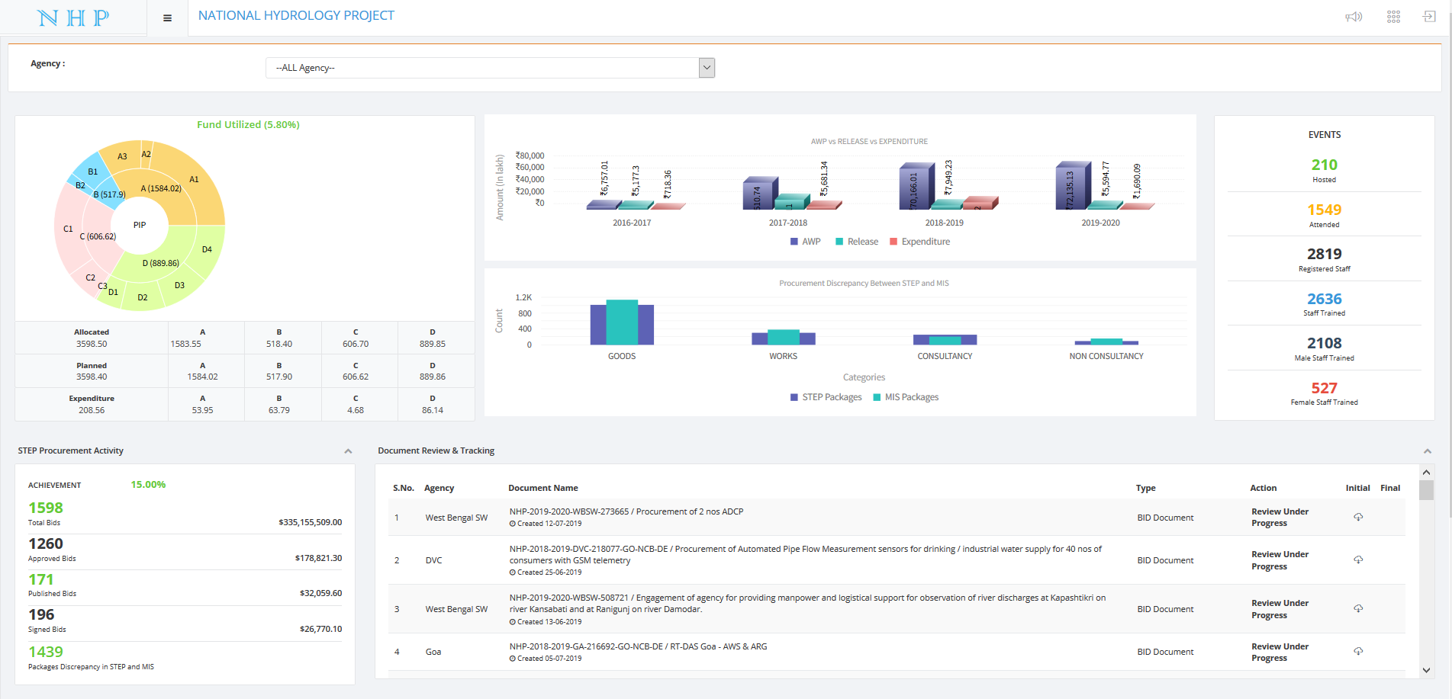
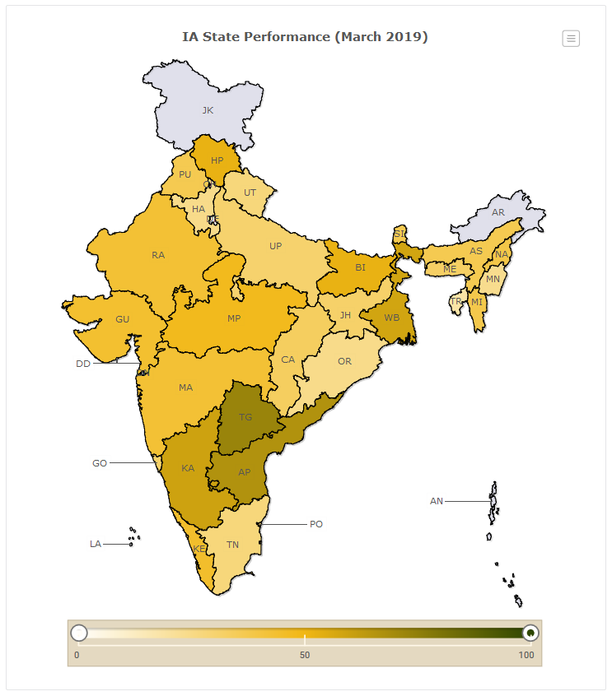
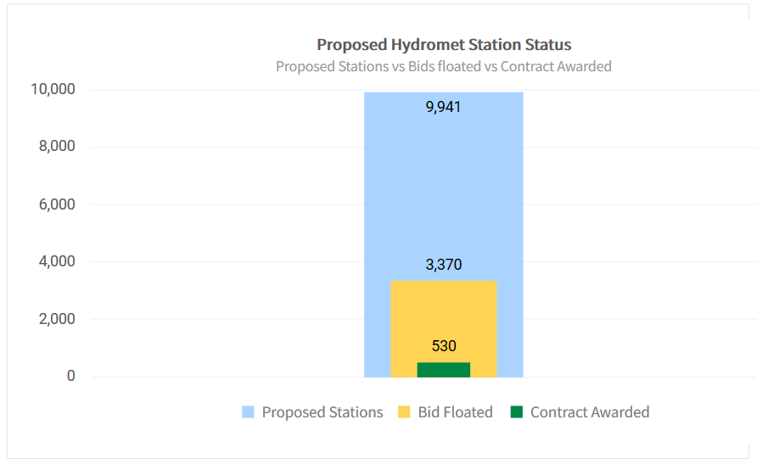
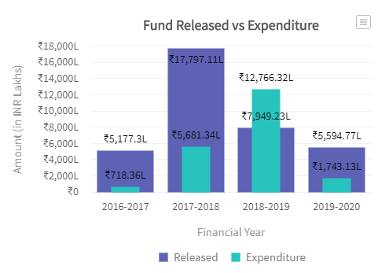
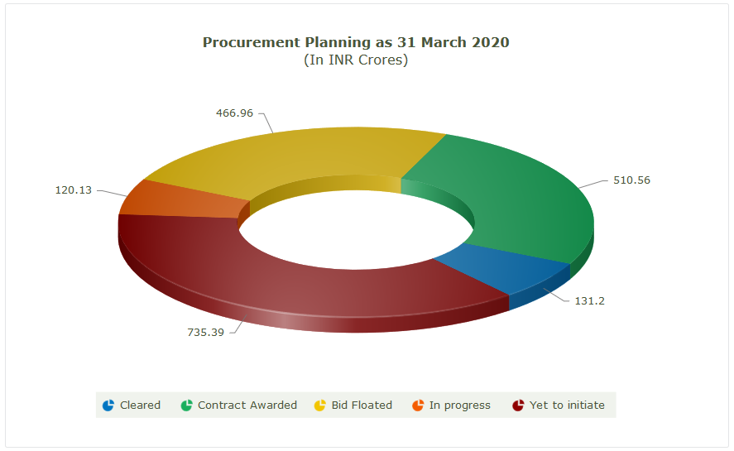
PROJECT DASHBOARD

Slide 5
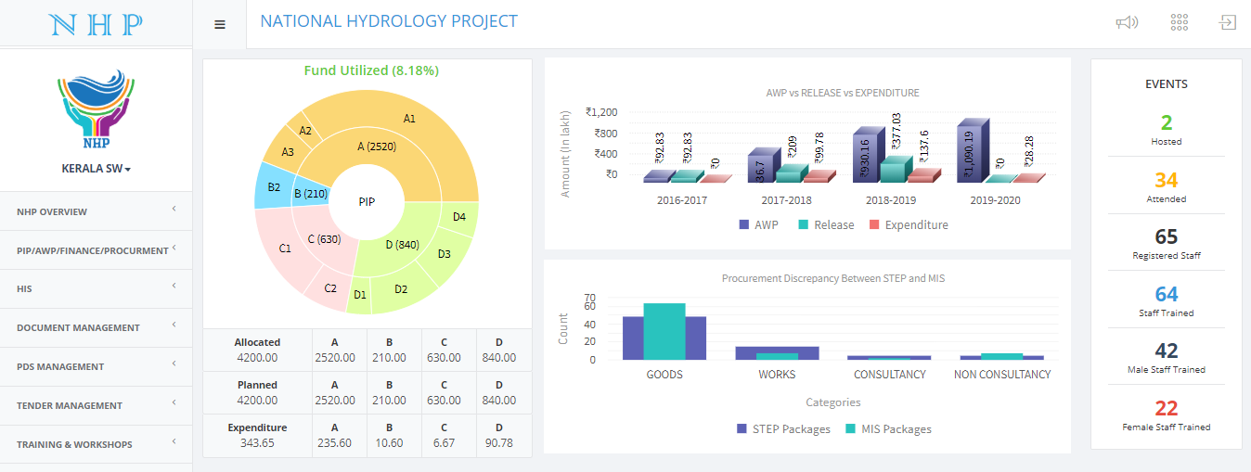
AGENCY DASHBOARD

Slide 6
PROCUREMENT
Procurement Planning Management
Re-bid
Cancel Procurement Package
Procurement Milestone
Integration with STEP (World Bank)
Bid Document Management
Tender Management

Slide 7
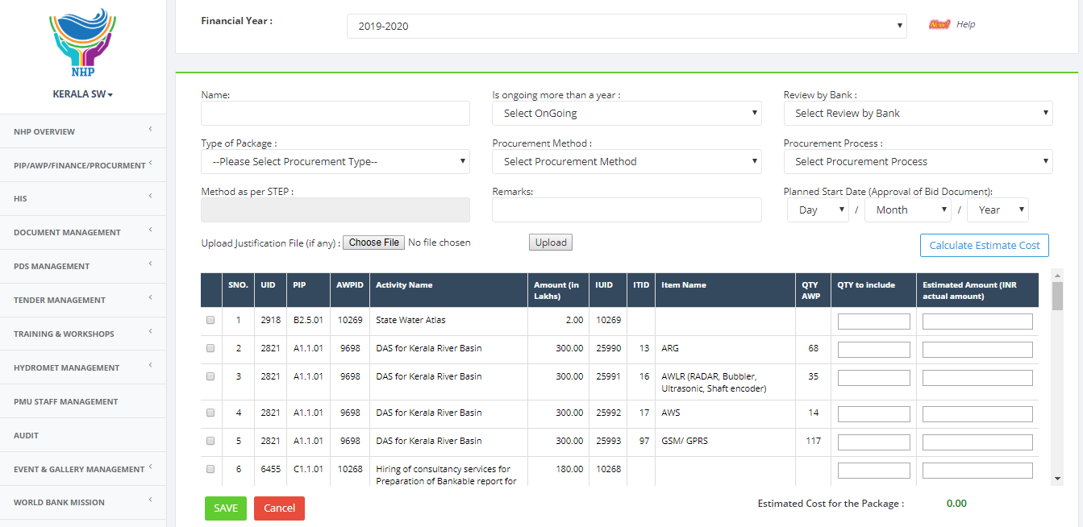
PROCUREMENT – PACKAGE CREATION

Slide 8
PROCUREMENT – CREATING NEW PLAN

Slide 9
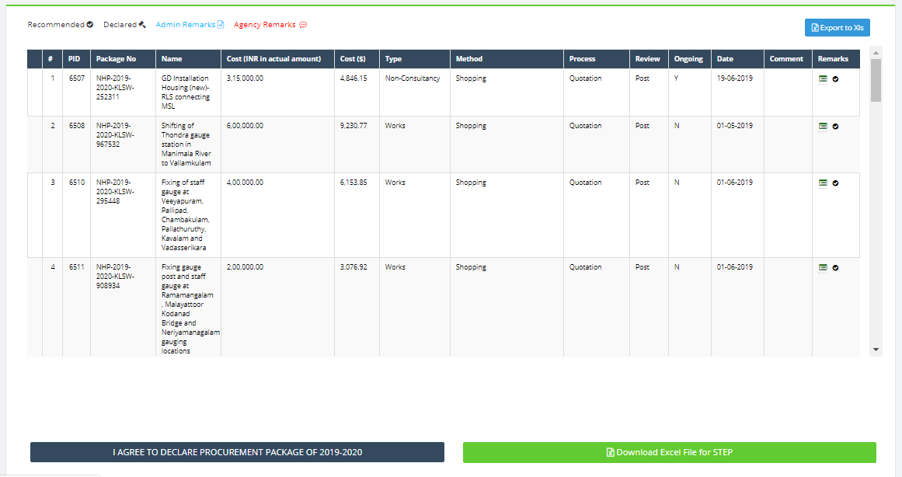
PROCUREMENT - PLAN

Slide 10
PROCUREMENT – RE-BID

Slide 11
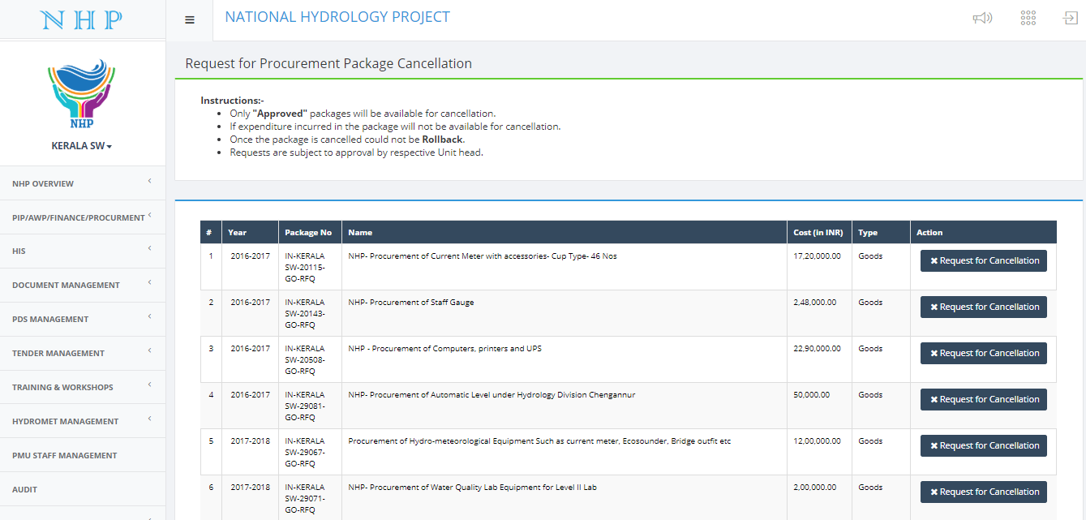
PROCUREMENT – PACKAGE CANCELLATION

Slide 12
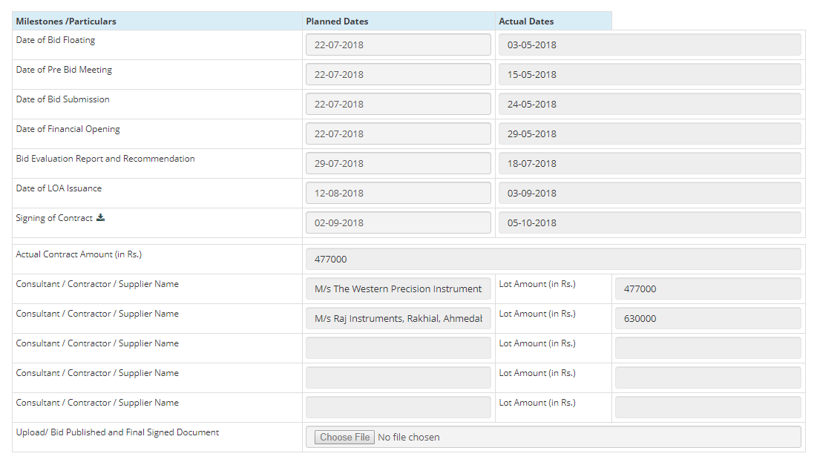
PROCUREMENT – MILESTONE

Slide 13
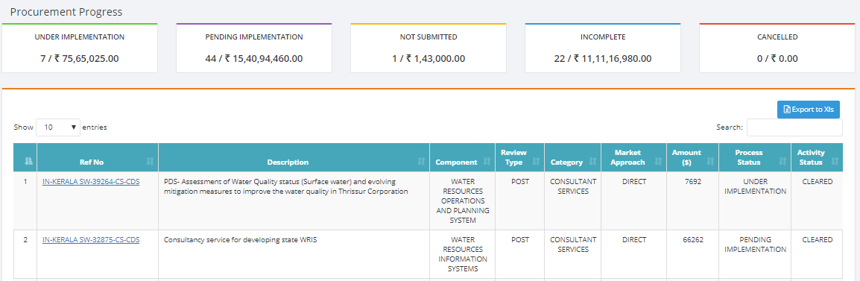
PROCUREMENT – INTEGRATION WITH STEP
Uploading STEP data to MIS
Updated STEP data in MIS from STEP
MIS & STEP data discrepancy

Slide 14
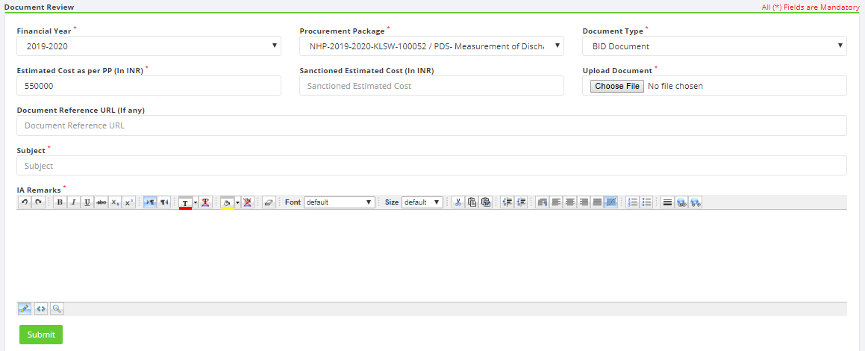
PROCUREMENT – DOCUMENT REVIEW

Slide 15
QUESTION & ANSWER SESSION

Slide 16
THANK YOU

